Slide 1

Azure Developer – Virtual Mentored Program
Azure Storage, Databases, & Azure Functions

Slide 2
Week 2 Content
Azure Storage
Database Offerings in Azure
Azure Functions (Part 1)

Slide 3
Azure Storage

Slide 4
Why do we need storage?
Cloud workloads in Azure often need the ability to persist important data (or state)
Without it, every interaction with our infrastructure would have to be standalone
Our virtual machines will likely need disk storage to support persistence of data about our applications and the runtime and configuration that supports them
Being able to compile data in storage provides us with the ability to group and catalog larger amounts of data for analysis
Notes:
Without storage, every interaction will require that the data needed for the interaction be supplied at time of request – we could make no assumptions about existing information
When seeking to analyze and make decisions based on a sample set of data, the larger the sample set, the more accurate the results of the analysis

Slide 5
Azure Storage – Benefits Provided
All data written to account is encrypted
Supports fine-grained control over access to the data
Azure handles underlying concerns like hardware, updates, etc.
Durable & Highly Available
Secure
Scalable
Managed
Accessible
Built in redundancy to protect against hardware failures
Supports sophisticated replication across data centers or geographies
High availability for critical data
Designed for Cloud scale and access performance at high demand
Access possible over HTTP/HTTPS globally
Client libraries available to support programmatic access in multiple languages
Azure Storage Explorer provides a nice UI
Notes:
Reduced operational responsibilities

Slide 6
First Step: Creating an Azure Storage Account
Multiple methods for creation supported, including Azure PowerShell, Azure Resource Manager (ARM) templates – a form of Infrastructure-as-Code, Azure CLI, and the Azure Portal
Requires some configuration details to define where the Storage Account will “live” in Azure – the subscription, resource group, and region
Also, needs a name – something globally unique
Notes:
Remember – a subscription organizes resource groups and resource groups organize resources.
Has to be globally unique because Azure will make the resources stored there available over the internet via URL

Slide 7
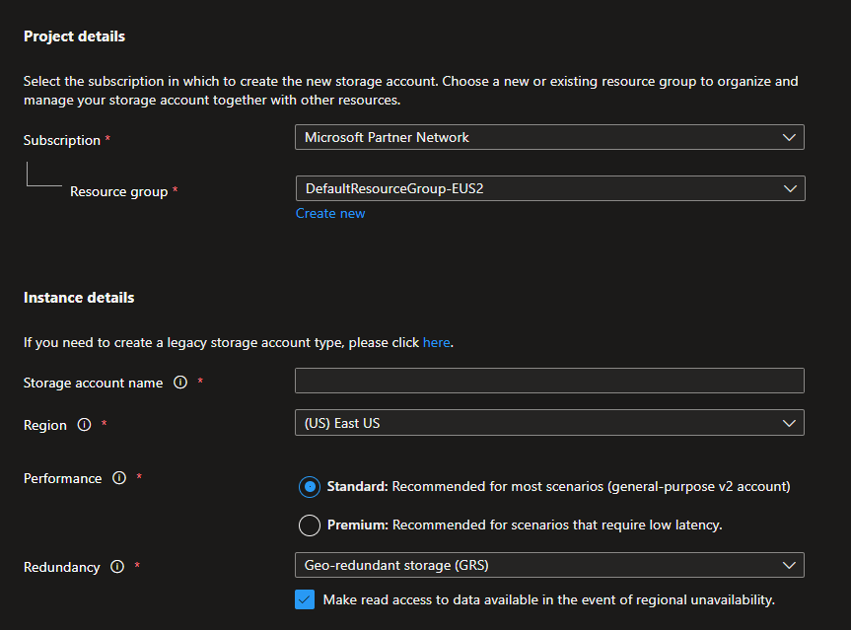
First Step: Creating an Azure Storage Account
Performance options include “Standard” and “Premium”
Standard will be utilized for most workloads
Premium is reserved for creation of disks used by virtual machines

Slide 8
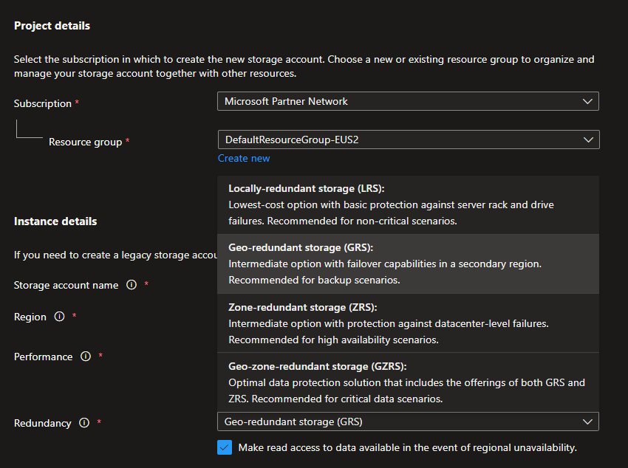
First Step: Creating an Azure Storage Account
Multiple redundancy options available
Protects against data loss with different types of infrastructure failure
More sophisticated levels of redundancy carry a higher cost

Slide 9
Redundancy Options
Locally Redundant Storage (LRS)
Replicates Storage Account 3 times within a single data center in primary region
Zone Redundant Storage (ZRS)
Replicates Storage Account across 3 availability zones in primary region
Offers least durability – does not protect against data center failure
Lowest-cost option
Write requests considered complete only after data successfully written to all 3 replicas
Provides improved durability with protection against a single data center failure
Write requests considered complete only after data successfully written to all 3 replicas across the availability zones
Good option for Azure Files workloads
Geo-Redundant Storage (GRS)
Copies data synchronously 3 times within a single physical location in the primary region (using LRS)
Then copies data asynchronously to single physical location in a secondary region with substantial distance from the primary region
Provides improved durability with protection against failure in a region
Geo-Zone-Redundant Storage (GZRS)
Copies data across 3 availability zones in the primary region
Also, replicates data using LRS to a data center in a secondary geographic region
Can provide protection against both data center and region failure
Most durable but also most expensive
Notes:
LRS – data that can be easily recreated or data restricted to storage in a single country/region due to government regulations
With GRS & GZRS, data in secondary region is not accessible unless in a failover situation; to further improve high availability, you can configure GRS or GZRS for read access in the secondary region as well. However, two items of note: 1) will be more expensive, since secondary region writes are async, there may be a delay before data is available from read from secondary

Slide 10
Azure Storage – Types
Blob
Disk
File
Archive

Slide 11
Azure Storage – Blob
Supports storage and access to unstructured data
Can be used to host static resources for serving a simple website
Can be used to store files, documents, bits of JSON, task definitions, etc.
Notes:
Unstructured means doesn’t adhere to a pre-defined structure or schema

Slide 12
Azure Storage – Blob
Can be used in support of audio or video streaming
Can be used to store backups for Business Continuity/Disaster Recovery (BC/DR)
Blob data lives in a container you create in the Storage Account represented as a flat-file hierarchy

Slide 13
Azure Storage – Disk
Provides virtualized backing storage for a virtual machine
Like a physical disk you’d find in a physical piece of infrastructure
But implemented as a separate, virtualized storage facility that enables reassociation to different VMs (if required)
Supports multiple options depending on performance requirements (premium solid-state, standard solid-state, and standard hard disk drives)
Notes:
If Azure needs to automatically replace a failed VM (e.g., as part of a VM scale set), need storage associated to the failed VM to be able to be associated to its replacement so we don’t’ lose key data

Slide 14
Azure Storage – File
Provides fully managed file shares in the Cloud for use in multiple other service offerings
Can be mounted in Cloud workloads as well as on-premise workloads
Offers very robust option for replacing on-premise file servers with a fully managed Cloud service that supports multiple file protocols and access to data across the globe

Slide 15
Azure Storage – Archive
Tiering is available for Blob containers in an Azure Storage Account
Offers different combinations of data retrieval performance and cost
Includes Hot, Cool, and Archive

Slide 16
Azure Storage – Archive
Hot
Provides fastest retrieval
Highest storage cost
Cool
Longer retrieval times
Medium storage costs
Archive
Longest retrieval times (on the order of hours)
Lowest storage cost
Lowest access cost
No minimum period for data storage
Medium access costs
30-day minimum period for data storage
Highest access cost
180-day minimum period for data storage
Notes:
Use Hot for data that you will be actively accessing; use archive for backups that require very infrequent access. Minimum periods refer to the amount of time (minimum) that data needs to remain stored there – if minimum is not met, can incur additional prorated costs. Data can be moved from one tier to another – just remain cognizant of the minimum storage periods.

Slide 17
Copy Tools for Moving Data into Blob Containers
Multiple options available
Azure Portal can be used for manually uploading files (not a good option at volume)
AzCopy can be used to automate file copy without user intervention
Azure Storage Explorer provides a nice GUI (graphical user interface) for managing and accessing files in containers

Slide 18
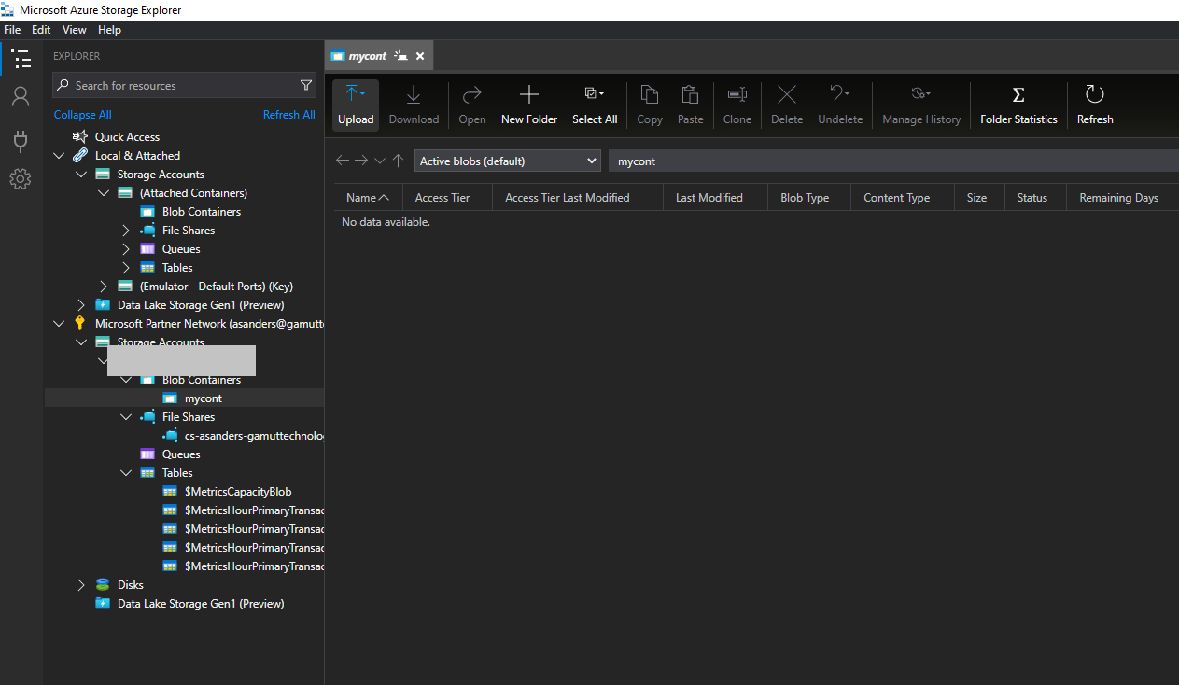
Azure Storage Explorer

Slide 19
Securing Access to Azure Storage Account
Multiple levels of security – security at the account level, at the container level, and at the individual file level for Blobs
Uses Azure Active Directory Role-Based Access Control (AAD RBAC) to secure at the account level
Uses access keys to secure at the account level or for individual containers
Uses something called Shared Access Signature (SAS) to secure at the individual Blob level

Slide 20
Storage Account Access Keys
Storage Accounts have a primary and secondary access key
Both a key and a related connection string are available for enabling scripted or programmatic access to the account
Should be protected and regularly rotated as a best practice for securing data in the account

Slide 21
Shared Access Signature (SAS)
SAS token can be generated by an authorized user or application for distribution to an end user
Represents a URI-friendly hashed string derived from the Storage Account access key
Provides more granular levels of access control on the account

Slide 22
Shared Access Signature (SAS)
Includes start and end times for limiting access to a specific time window (safer)
Allows specification of the types of access to allow (read, write, create, list, delete)
Can be generated for the entire Storage account, for a specific container, or individual files

Slide 23
Stored Access Policy
Provides a common reference for creating multiple SAS tokens
The policy defines permissions, time frame, etc. – SAS tokens generated from the policy use the common configuration
Management of the policy can be used to manage all tokens generated from it
Only applies at the container level, not individual files

Slide 24
Azure Storage
Demo
Notes:
https://docs.microsoft.com/en-us/azure/storage/blobs/storage-blob-static-website-host
Use Azure Storage to host a static website
RG → static-website
Account name → az900staticwebsite
Use LRS → go straight to create
Review “Access keys” and “Shared access signature” generation. Also “Configuration”.
Delete folder and delete resource group → `az group delete --name <name of group>`

Slide 25
Azure Storage
Demo
Notes:
https://docs.microsoft.com/en-us/azure/storage/blobs/storage-quickstart-blobs-nodejs?tabs=environment-variable-linux
Manage blobs with JavaScript v12 SDK in Node.js

Slide 26
Azure Storage
Lab
Notes:
https://docs.microsoft.com/en-us/azure/developer/java/spring-framework/configure-spring-boot-starter-java-app-with-azure-storage?toc=%2Fazure%2Fstorage%2Fblobs%2Ftoc.json
How to use the Spring Boot Starter for Azure Storage
https://docs.microsoft.com/en-us/azure/storage/blobs/storage-quickstart-blobs-python?tabs=environment-variable-windows
Manage blobs with Python v12 SDK

Slide 27
Database Offerings in Azure

Slide 28
Database Offerings in Azure
SQL Server
PostgreSQL
Notes:
These are not the only DB offerings but these are 2 of the key ones. We’ll explore some of the others (e.g., CosmosDB in a future session)

Slide 29
SQL Server
Microsoft’s Relational Database Management System (RDBMS)
Uses tables with columns to describe an entity type and rows to represent instances of that entity
Unlike NoSQL, utilizes a strict schema for defining data structures
Supports organizing and connecting related entities using keys and table relationships
Supports network connectivity for connecting and operating on data remotely
Notes:
Normalization – organizing data in a relational way that minimizes data duplication and allows searches by key through a hierarchy

Slide 30
SQL Server in Azure - Options
SQL Server on Azure VM
Azure SQL
Azure SQL Managed Instance
Uses a virtual machine created in Azure (IaaS)
Customer downloads, installs, and manages SQL Server software & instance on the VM
Fully managed service
Does not provide access to all features available with SQL Server installed on a VM
Fully managed service
Has more compatibility with on-premise instances and IaaS instances installed on a VM
Better supports common tools used with SQL Server-based workloads
Notes:
Tradeoff again in terms of cost vs. capability (common)
Walk through process of creating in portal

Slide 31
Azure Database for PostgreSQL
PostgreSQL is an open-source database product
Uses tables, columns, rows, and relationships to create a hierarchy of application entities (relational) but also supports non-relational (NoSQL) data
As with the other types, supports network connectivity for connecting and operating on data remotely
Azure’s service provides a fully managed instance of the DB platform
Notes:
https://docs.microsoft.com/en-us/azure/postgresql/single-server/overview-postgres-choose-server-options
Compare costs → https://azure.microsoft.com/en-us/pricing/calculator/
Walk through process of creating in portal + https://docs.microsoft.com/en-us/cli/azure/postgres/flexible-server/db?view=azure-cli-latest#az-postgres-flexible-server-db-create to create database

Slide 32
Azure PostgreSQL
Demo
Notes:
https://docs.microsoft.com/en-us/azure/app-service/tutorial-python-postgresql-app?toc=https%3A%2F%2Fdocs.microsoft.com%2Fen-us%2Fazure%2Fpostgresql%2Ftoc.json&bc=https%3A%2F%2Fdocs.microsoft.com%2Fen-us%2Fazure%2Fbread%2Ftoc.json&tabs=flask%2Cwindows%2Cazure-portal%2Cterminal-bash%2Cazure-portal-access%2Cvscode-aztools-deploy%2Cdeploy-instructions-azportal%2Cdeploy-instructions--zip-azcli%2Cdeploy-instructions-curl-bash
Deploy a Python (Django or Flask) web app with PostgreSQL in Azure

Slide 33
Azure PostgreSQL
Lab
Notes:
https://docs.microsoft.com/en-us/azure/developer/java/spring-framework/configure-spring-data-jdbc-with-azure-postgresql?toc=%2Fazure%2Fpostgresql%2Ftoc.json&bc=%2Fazure%2Fbread%2Ftoc.json
Use Spring Data JDBC with Azure Database for PostgreSQL

Slide 34
Azure Functions (Part 1)

Slide 35
Azure Storage + Functions (Bringing It Together)
Demo
Notes:
https://docs.microsoft.com/en-us/azure/storage/blobs/blob-upload-function-trigger?tabs=azure-portal
Upload and analyze a file with Azure Functions and Blob Storage

Slide 36




Best of luck as you forge ahead on your Cloud journey!

